Slide 1

NAKUJA 4 SOLIDS TEAM
WEEK 2 PROGRESS REPORT

Slide 2

THIS WEEK’S OBJECTIVES:
Analysis and research of the previous static test
Preparation of the tensile test workpieces
Conducted the tensile test on the specimens.
Developing calculations for the new casing.
Searching for suppliers of the new casing.
Cutting of the bulkhead material.
Re-making of the liner.

Slide 3
1.Results from the analysis
Calculated working pressure was found to be equal to the simulated motor pressure.
The liner acted as an insulating layer and ablative layer where pyrolysis occurred.

Slide 4
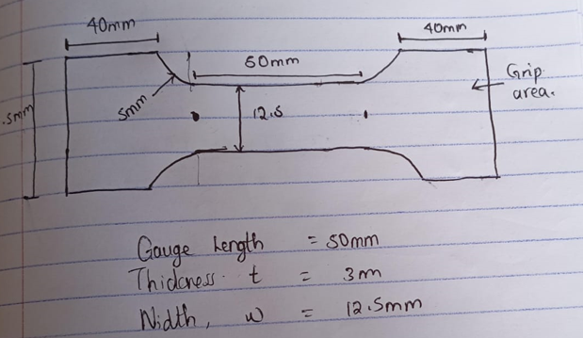
2.Preparation of the tensile test work pieces
Using hacksaws,square files and round file a work piece was made from the aluminium casing according to the ASTM B557M Standard.
Fig 1: Dimensions of work piece with standards

Slide 5
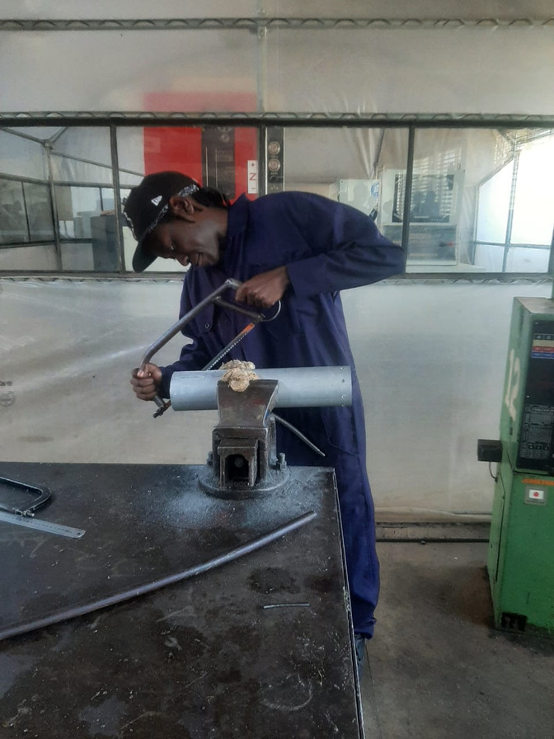
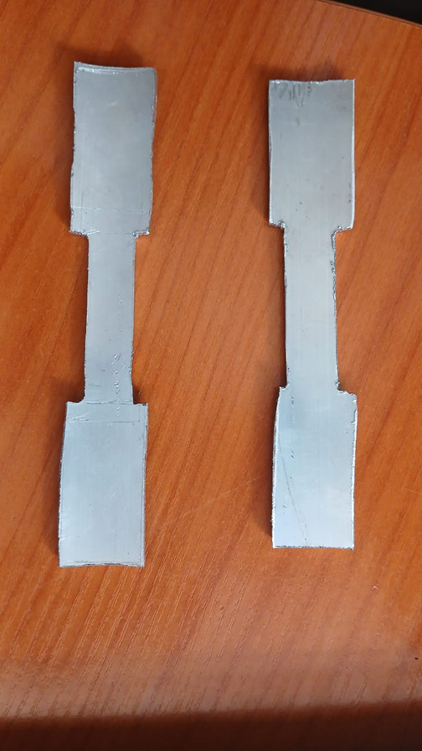
Photo of the activity.
Fig 2. Workpiece preparation
Fig 3. Workpieces after activity

Slide 6
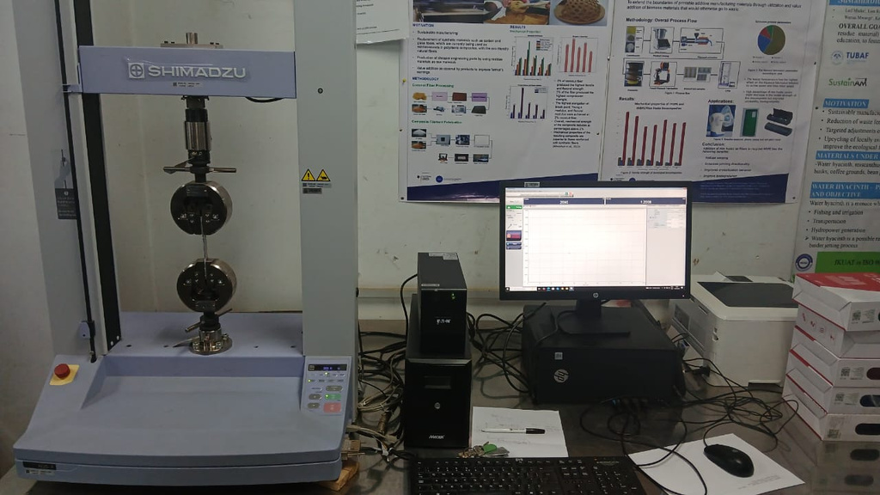
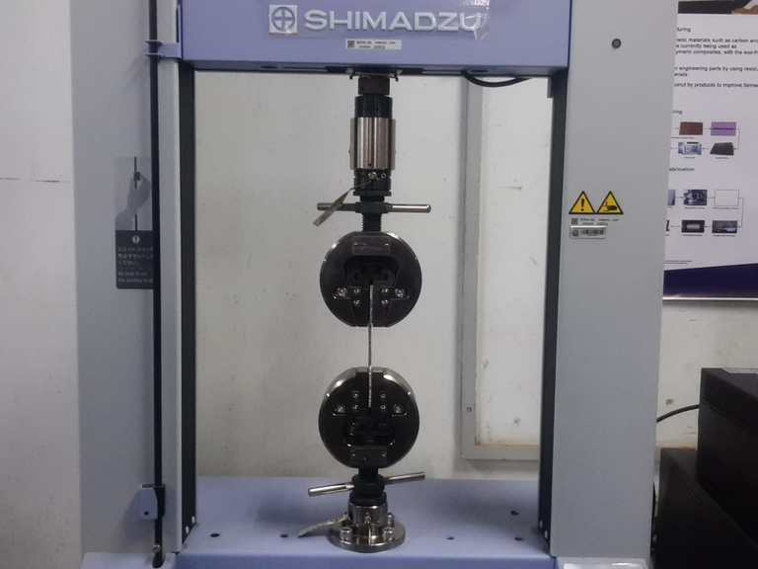
3.Tensile testing
The specimen were tested using a Shimadzu universal tensile testing machine.
The method was customised within the Trapeziumx software and the batch number specified. The specimen was loaded onto the jaws of the machine and loading began.
Fig 4. Tensile test setup
Fig 5. Workpiece in machine

Slide 7
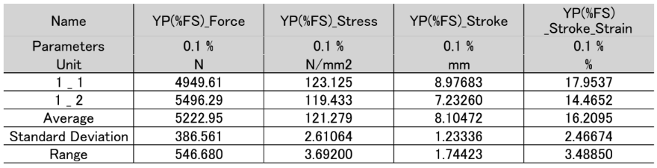
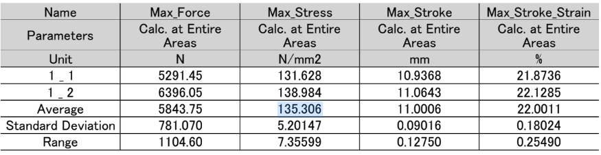
Results of the tensile test

Slide 8
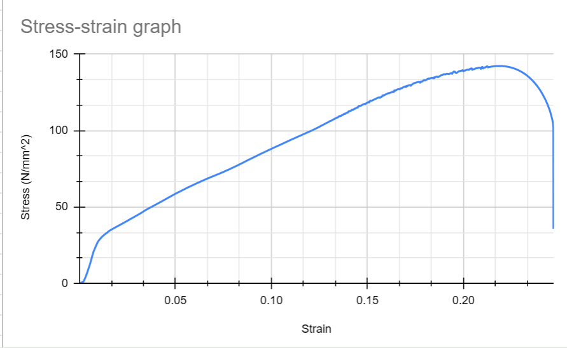
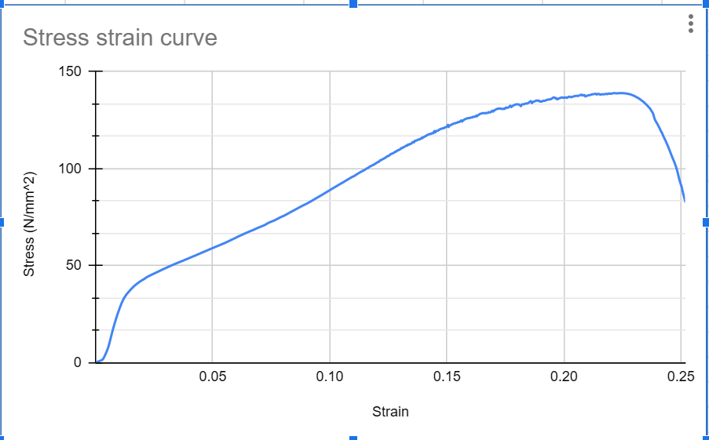
Excel analysis of the results
Sample 1 stress-strain curve
Sample 2 stress-strain curve

Slide 9
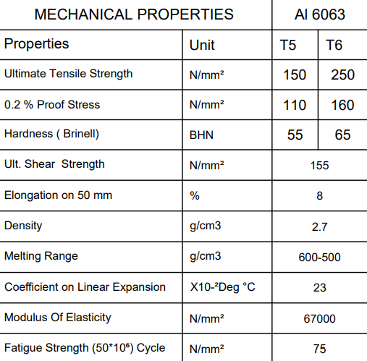
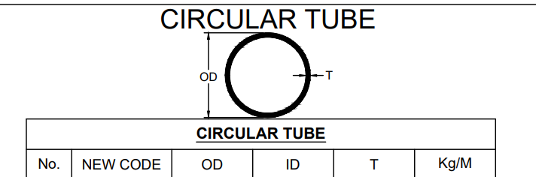
Mechanical properties from the supplier

Slide 10
Conclusion of the test
From the tensile test, it is evident that the Yield stress from the supplier was concurrent with yield stress of the test. The same is true for the Ultimate tensile stress

Slide 11
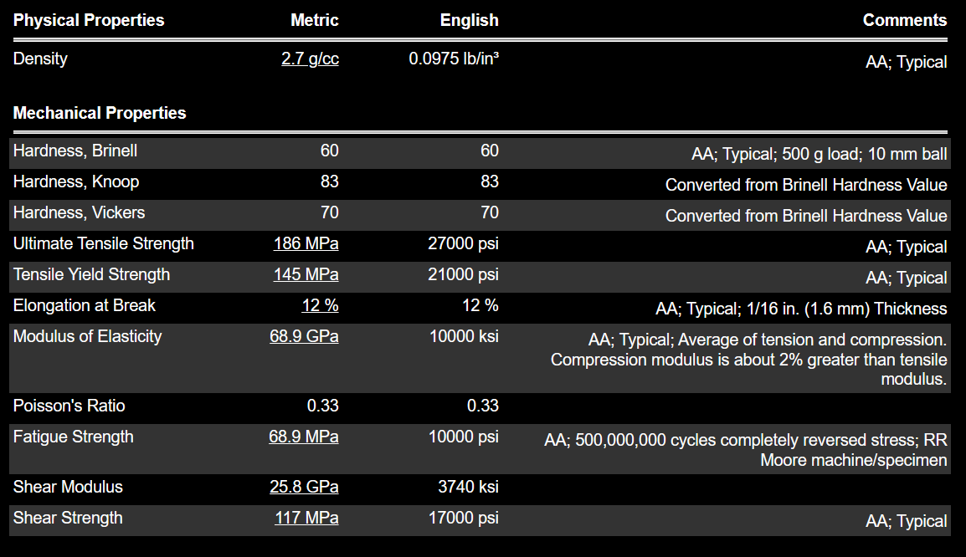
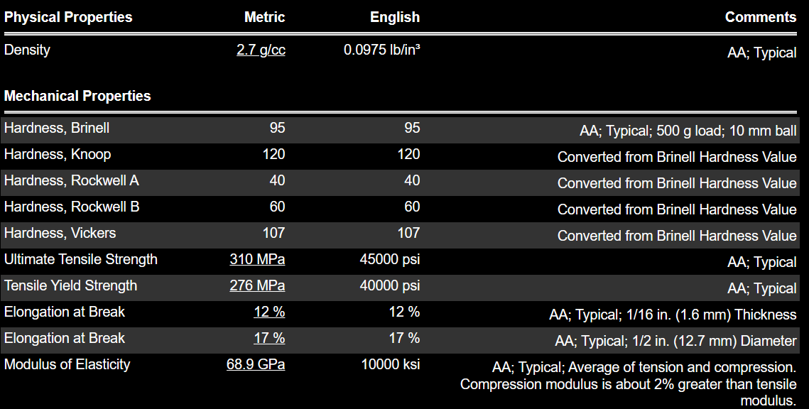
Material properties of different Al alloys
Al 6063 T5
Al 6061 T6

Slide 12
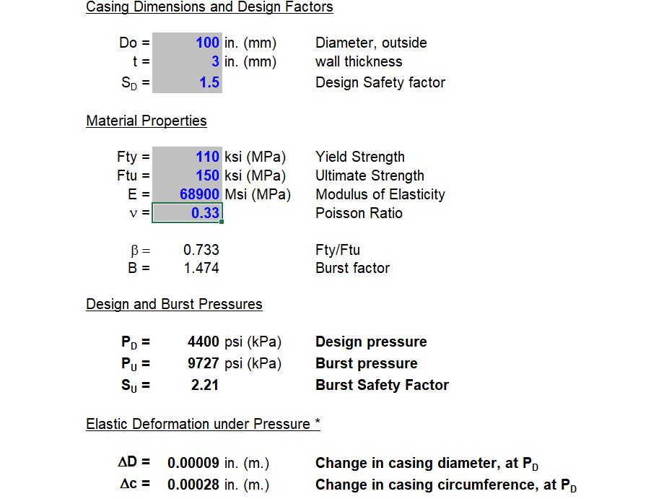
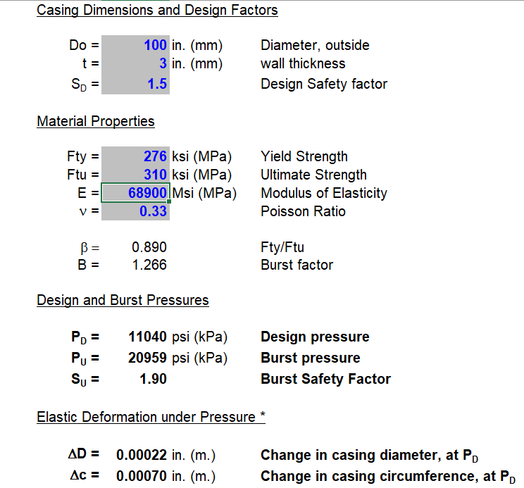
4.Calculation of the casing
Fig 12. Casing calculations for AL 6063 T5
Fig 12. Casing calculations for AL 6061 T6

Slide 13
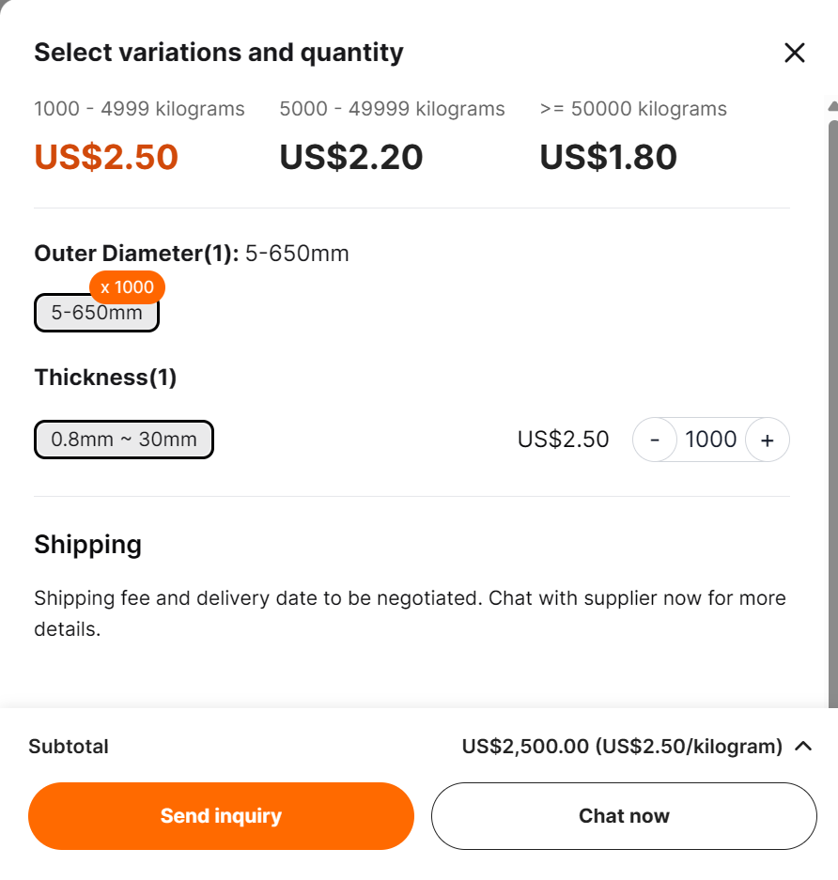
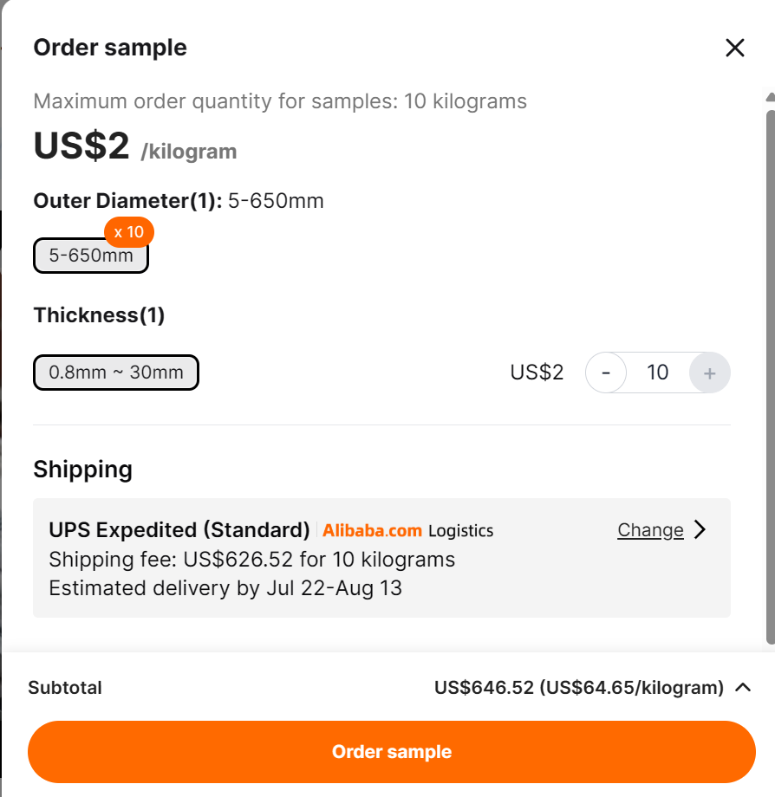
5.Suppliers from the internet
Fig 14&15. Alibaba supplier

Slide 14
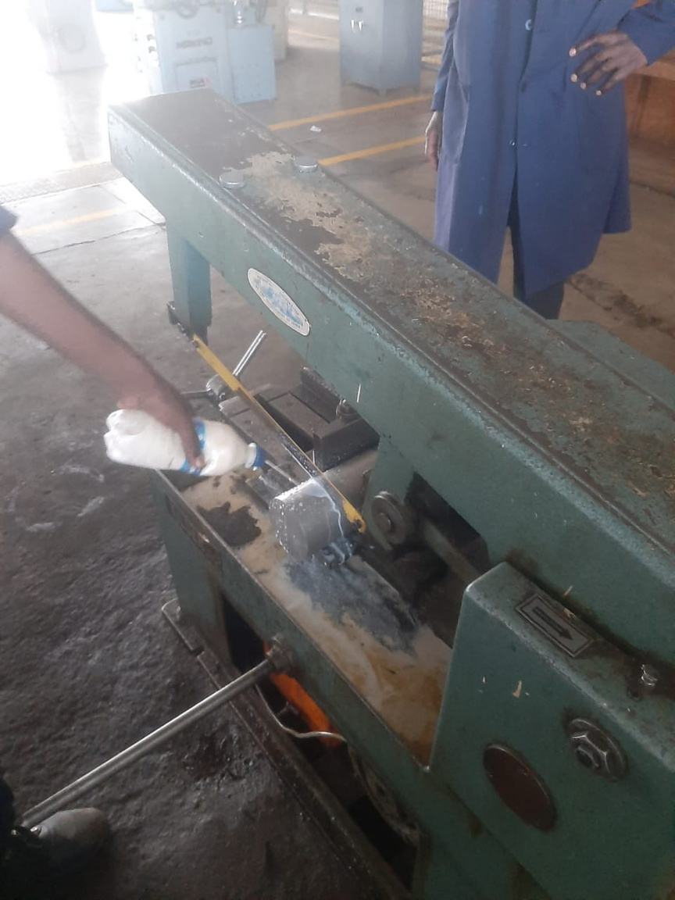
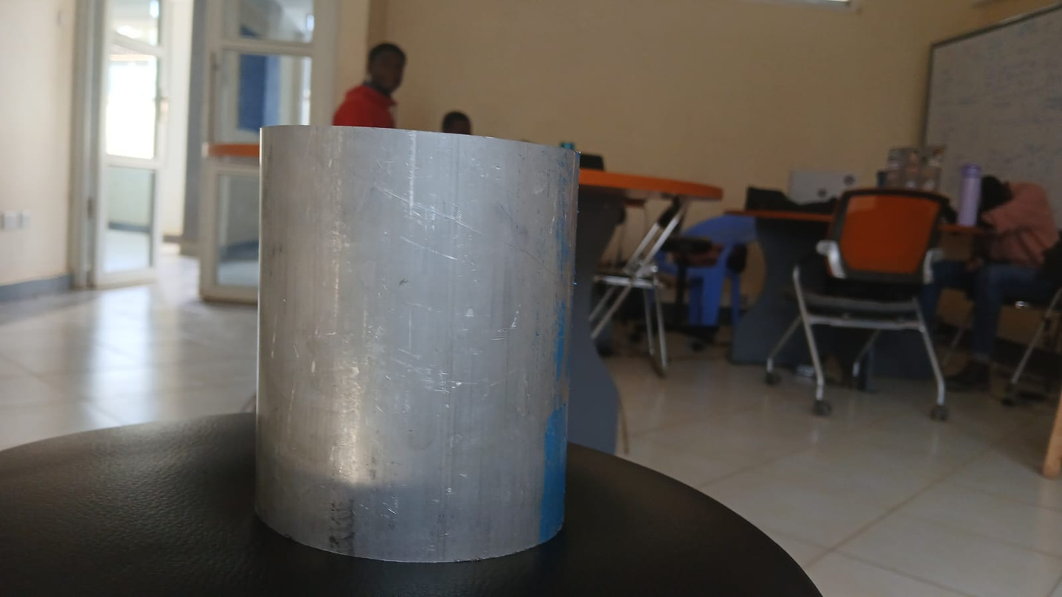
6. Cutting of the bulkhead to specific size.
Fig 16. Bulkhead material cut to dimension

Slide 15
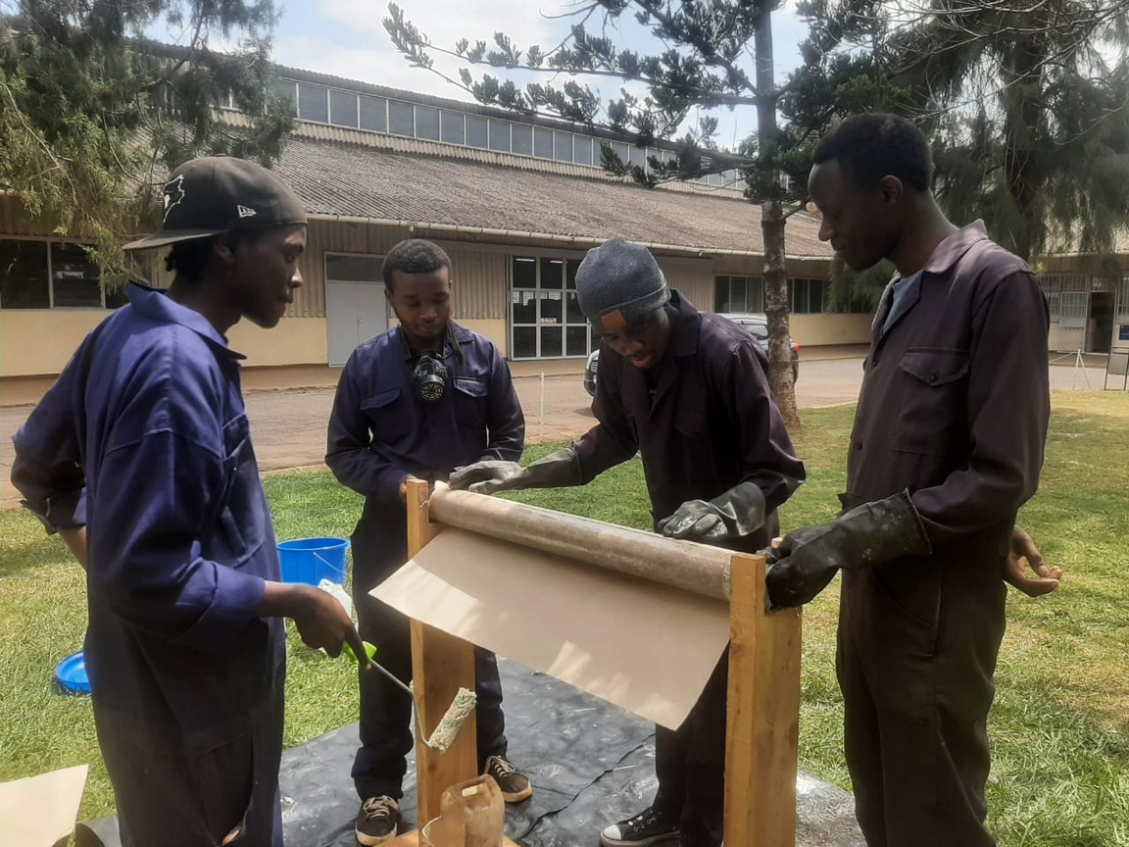
Re-making of the Liner according to the new casing dimensions
Fig 16. Liner made to 94mm dimension

Slide 16
NEXT WEEK’S OBJECTIVES
Simulating of the new casing performance in Ansys
Machining of the bulkheads to be used in the hydrostatic test (consult on how to conduct our own pressure test during hot fires - piping system connection)
Conducting the hydrostatic test
Obtaining Sorbitol and Potassium Nitrate
Cooking of the grains

Slide 17
THANK YOU
N4 SOLIDS TEAM

